Slide 1
Upgrading BC Hydro’s Inflow Forecast System
Adam Gobena, BC Hydro
Georg Jost, BC Hydro
Scott Weston, BC Hydro

Slide 2
Topics covered
BC Hydro Overview
Inflow Forecasting at BC Hydro
Modernizing the forecast system – why and how?
Some outputs from the new system
Future plan
Notes:
Please complete safety information.

Slide 3
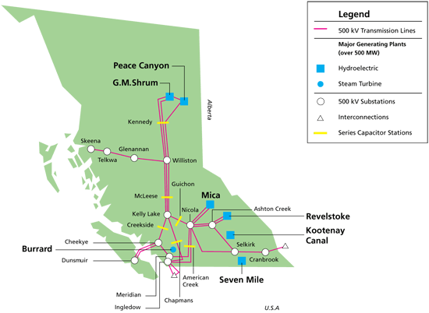
BC Hydro – Quick facts
Provincial crown corporation
Serves 95% of BC (1.8 million customers)
11,300 MW capacity (3rd largest in Canada)
99% hydroelectric and 1% thermal
85% of generation from Peace and Columbia

Slide 4
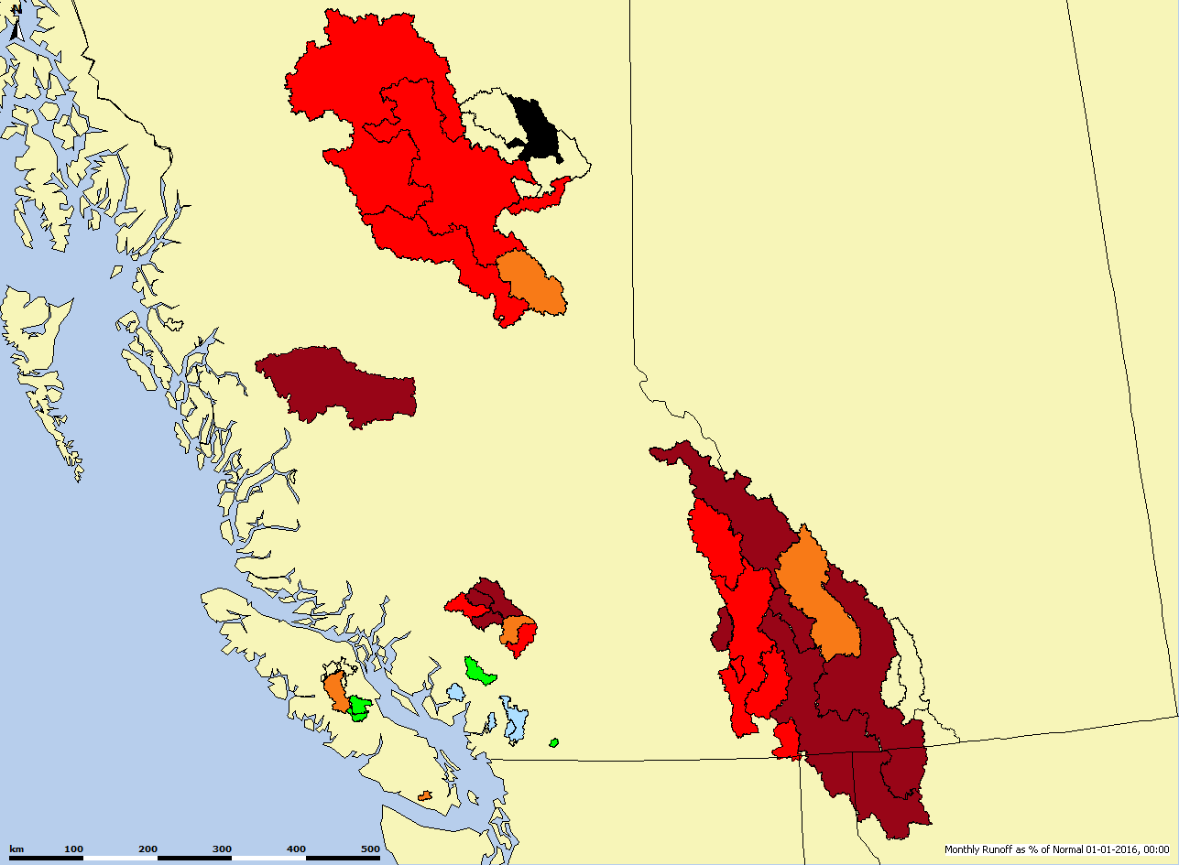
BC Hydro System - watersheds
21 watersheds with storage reservoirs
Short range deterministic forecasts
Short range probabilistic forecasts
Long range ensemble forecasts
Statistical water supply forecasts
Forecasts during construction work
Climate change projections
Forecast system development
Forecast verification
Value-added analysis of data
3 hydrologists
British Columbia

Slide 5
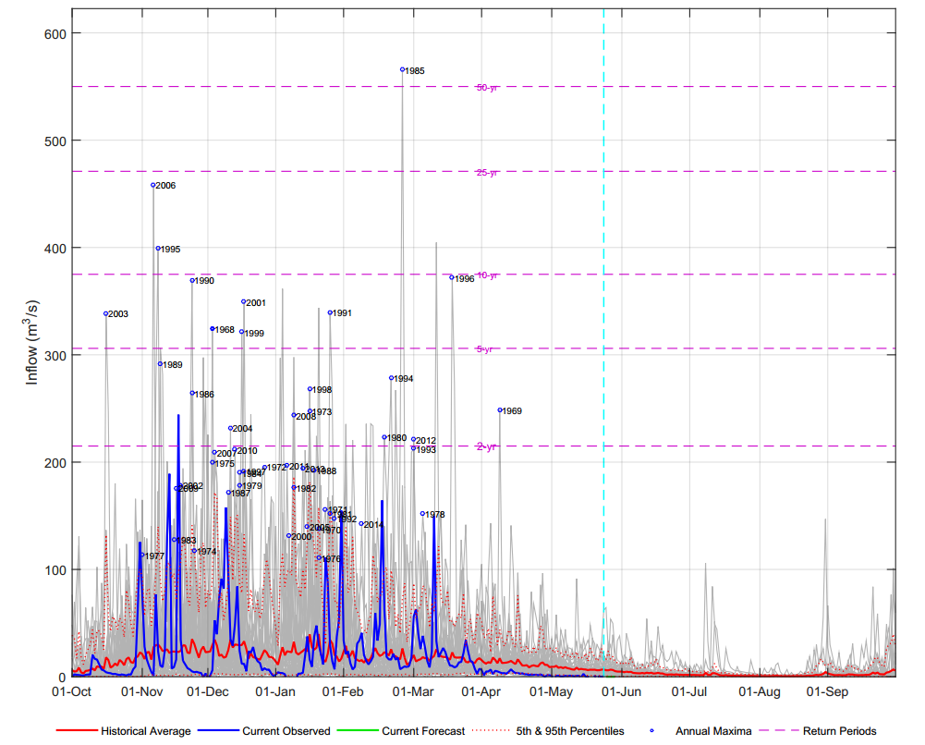
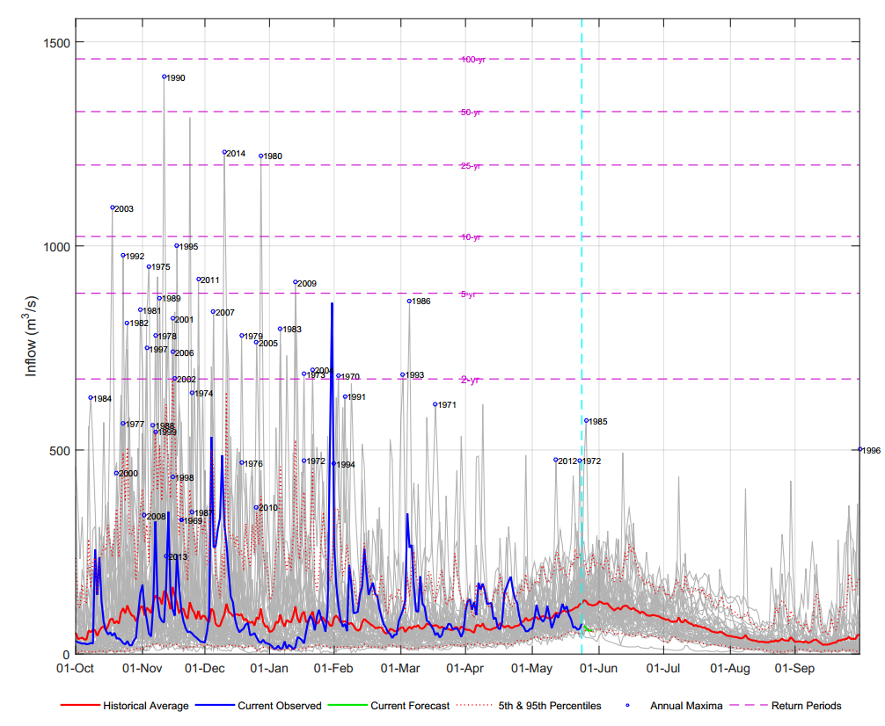
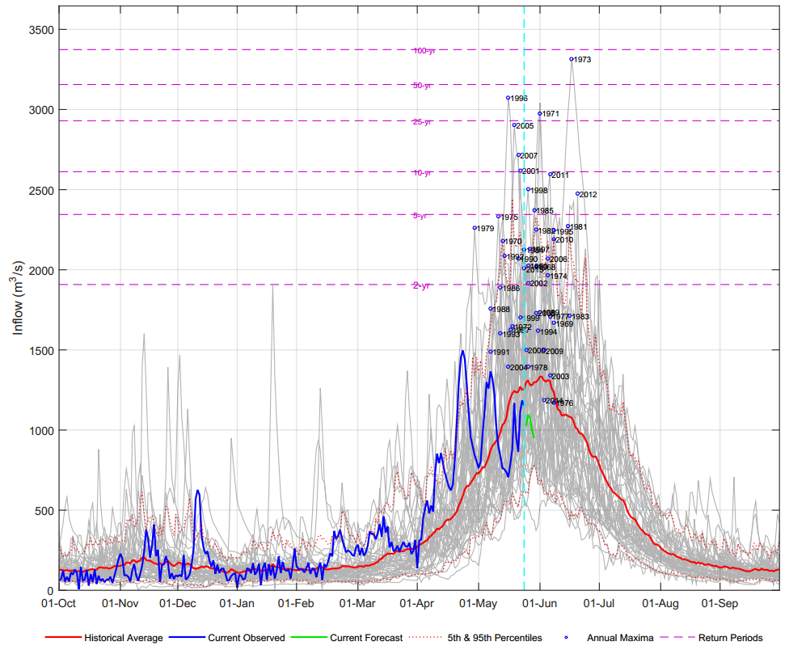
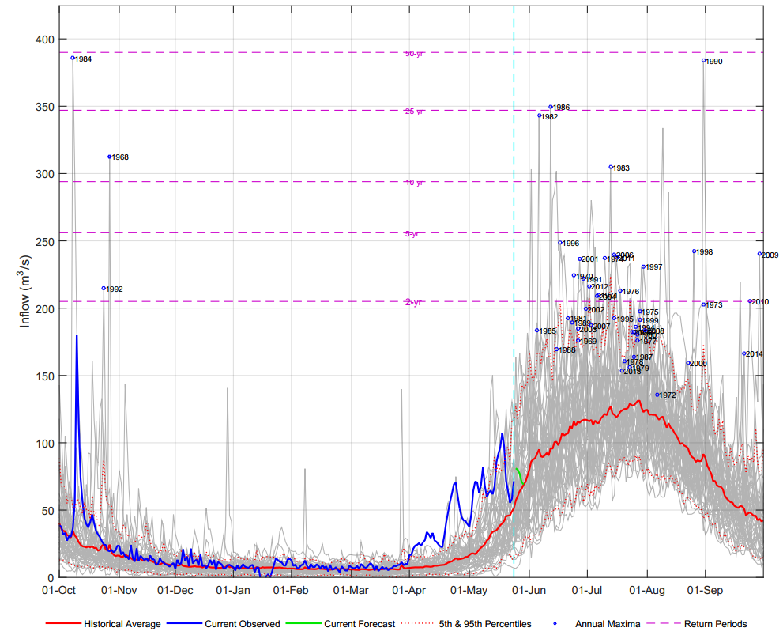
Hydrologic regimes in the system …
Pluvial (Coastal)
Hybrid/ pluvial-nival (Coastal)
Nival (South Interior)
Nival-pluvial (North Interior)
Hybrid/ nival-glacial

Slide 6


Inflow forecasting at BC Hydro
Inflow forecasting for reservoir operations since 1970s
Prior to 2002 – UBCWM for ESP & the Stanford Hydrology Model for short-range forecasting.
In 2002, both short-range and ESP incorporated into the River Forecast System (RFS) , a custom-built forecast system using the UBCWM as the core engine.
UBCWM is a 1970s era, process-oriented model, run in a lumped/semi-distributed mode (7 to 11 elevation bands) , at daily time step.
The modeling platform and forecast system have pretty much become obsolete compared to changing user demand and current technology.
Key capabilities we wanted to have in the forecast system included:
  Modularity
  Flexibility
  Increased discretization (both in time and space)
  Improved process modeling
  Automation of routine tasks
RFS ➔
(2002-2015) (2014- ----)

Slide 7
Why Raven?
More than just another hydrological model
Flexible modelling platform
  extensive library of process algorithms
  Flexible spatial discretization
  parameter autogeneration
  powerful & intuitive I/O
  robust error-checking, etc., etc.
Build different models on the fly
Build your own model by choosing from library of process algorithms
Build your own model by adding your own equations to library of process algorithms
Primary Author
James Craig, jrcraig@uwaterloo.ca

Slide 8
Raven: Build a model at runtime
Chose an existing model, modify and existing model or build your own.
Forcing functions
Process formulation

Slide 9
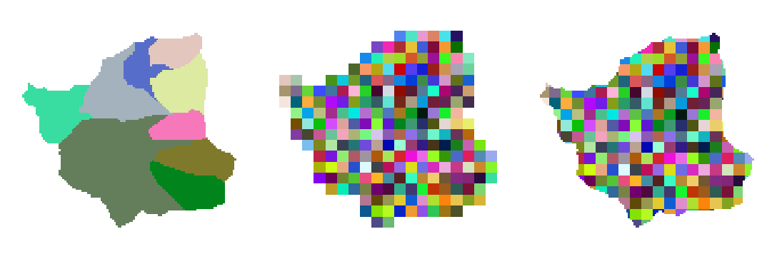
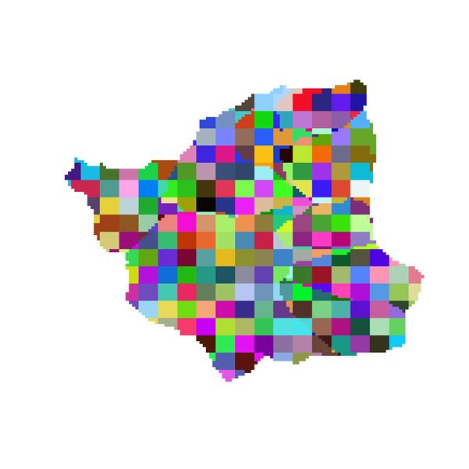
Raven: Flexible discretization
Sub-basin HRU Grid

Slide 10
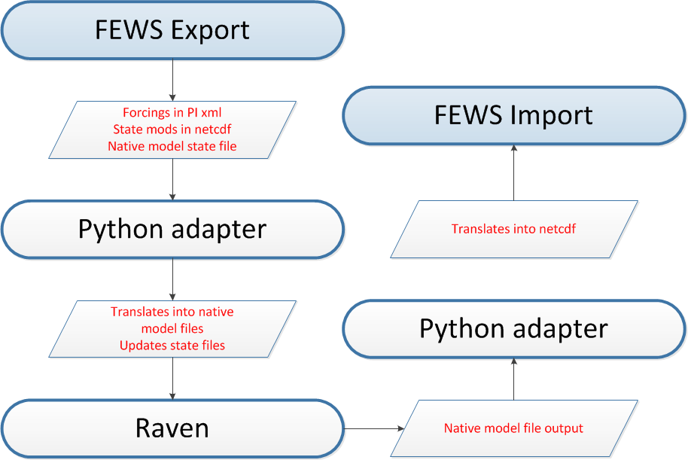
Raven - FEWS interface
Model decoupled from forecasting system.
Relatively loose connection between FEWS and Raven
Easy to plug in another model given no changes to I/O
A bit more work if model uses different inputs and different discretization
Plan to move python adapter to C++ (dll)

Slide 11
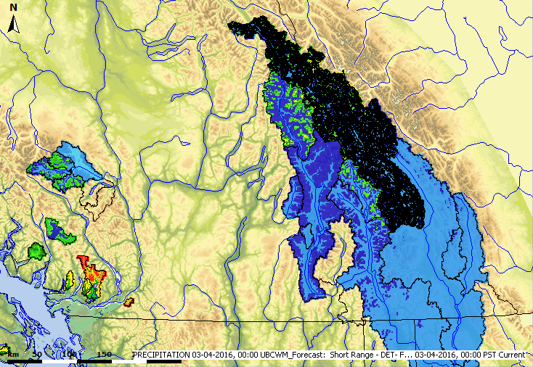
Raven – FEWS spatial data
Snowpack is the most important state variable for many of our watersheds
High enough resolution to calibrate to observed SWE

Slide 12
RFS snow data assimilation
The basis for assimilation is a LSR model between observed SWE at snow courses and model simulated SWE (interpolated to same elevation as snow courses)
Eyeball through the scatter (subjective)
Apply same adjustment to all land cover types

Slide 13
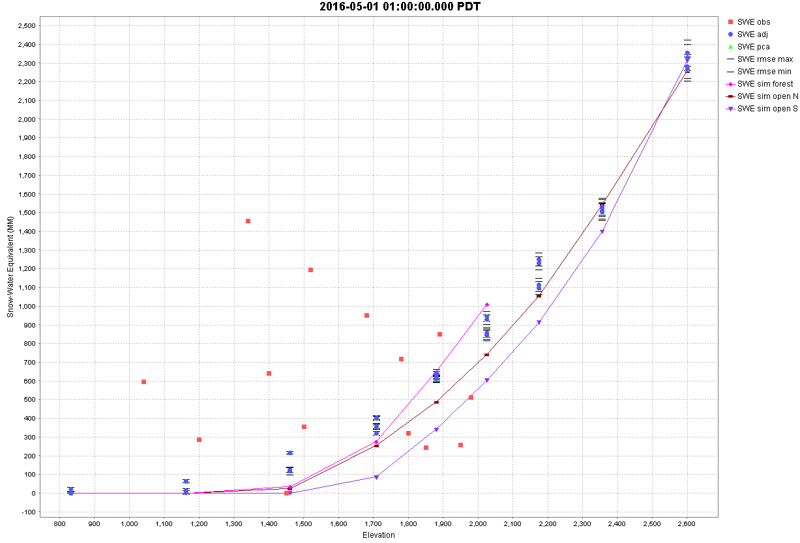
Raven – FEWS snow data assimilation
The basis for assimilation is PCR between observed SWE at snow courses and simulated HRU SWE
No instrumentation above ~2000m, roughly 40% of DA for this basin
PCA for every HRU (objective?)
SWE vs Elevation for major land cover types (Forest, Open South, Open North)

Slide 14
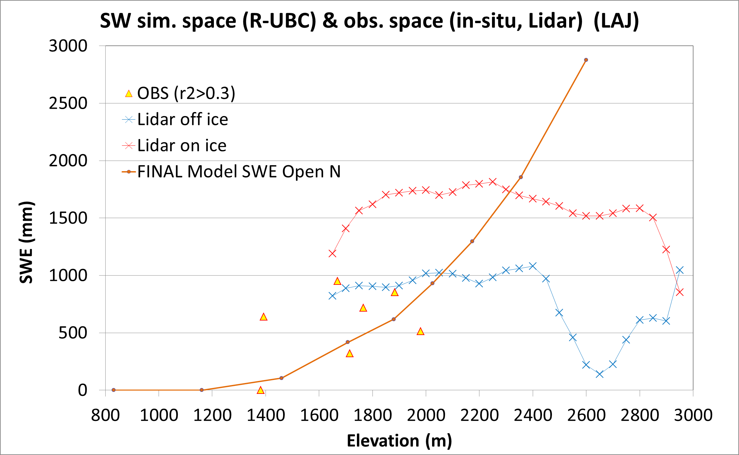
LiDAR for high elevation snow monitoring
Need at least a few years before we use it quantitatively

Slide 15
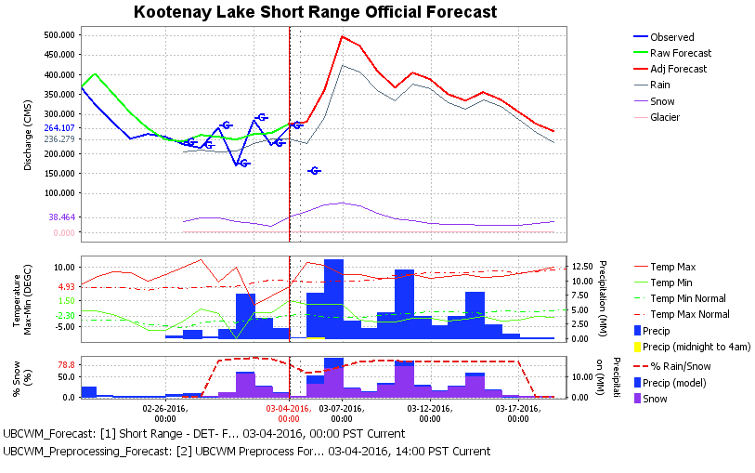
Forecasting in Raven – FEWS
Raven has built-in tracer model for hydrograph separation
Built-in transport model for hydrograph separation into rain, snow and glacier runoff
Rain-snow partitioning (esp. useful during rain-on-snow events)

Slide 16
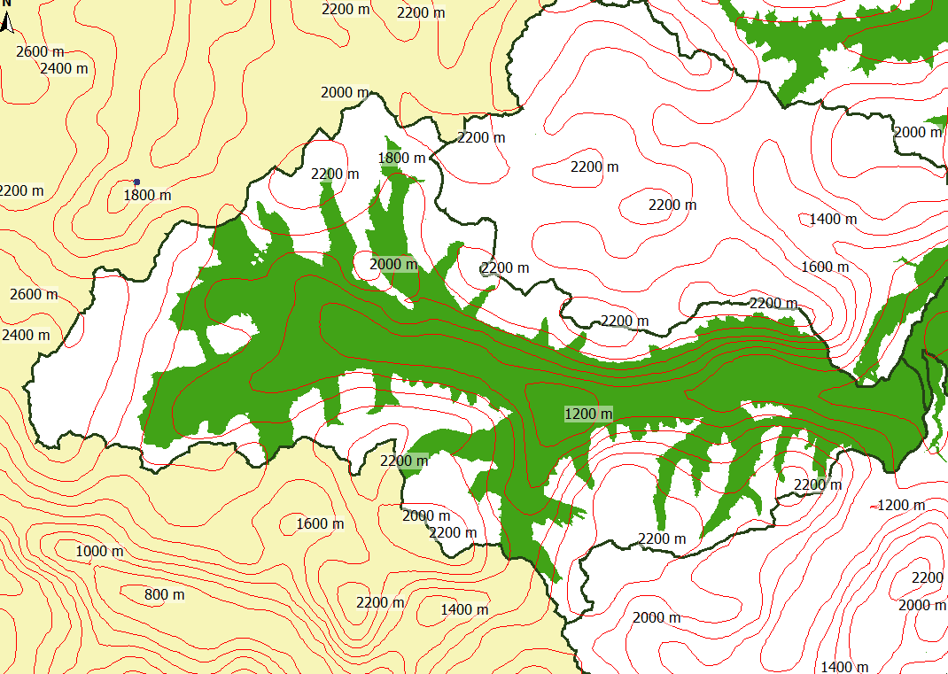

Freezing Temperature map
Superimposed on MODIS snow cover to identify rain-on-snow events

Slide 17
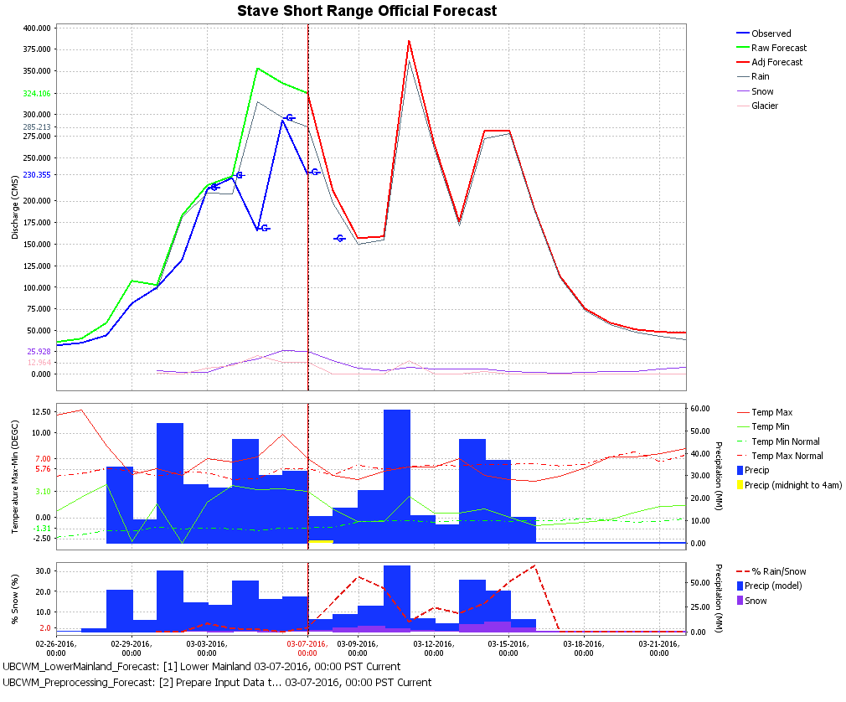
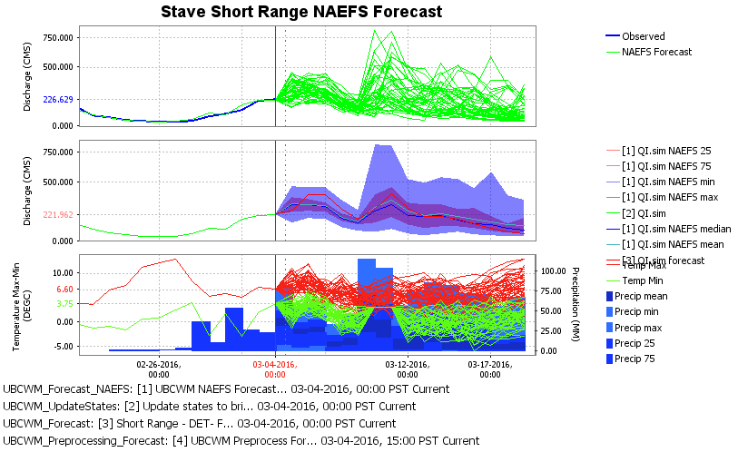
Probabilistic forecasting
RFS Raven-FEWS
Primarily deterministic Deterministic/Probabilistic

Slide 18
Weather forecast uncertainty
Raw NAEFS forecast
  North American Ensemble Forecasting System
  Total of 42 members running 15 days out
  ~50km resolution
Postprocessing
(at UBC)
  Bias correction
  Dispersion correction
FEWS/Raven
  Scheduled runs
FEWS
  Postprocessing

Slide 19
Raven Direct Model Output
NAEFS too coarse esp. for small, flashy coastal basins
Official forecast: deterministic (RDPS+NAEFS median)
RDPS ~ 10k resolution but only runs 2 day forecast
Very little skill in forecasts beyond day 8
Probabilistic inflow forecast has highest value between day 3 and day 8

Slide 20
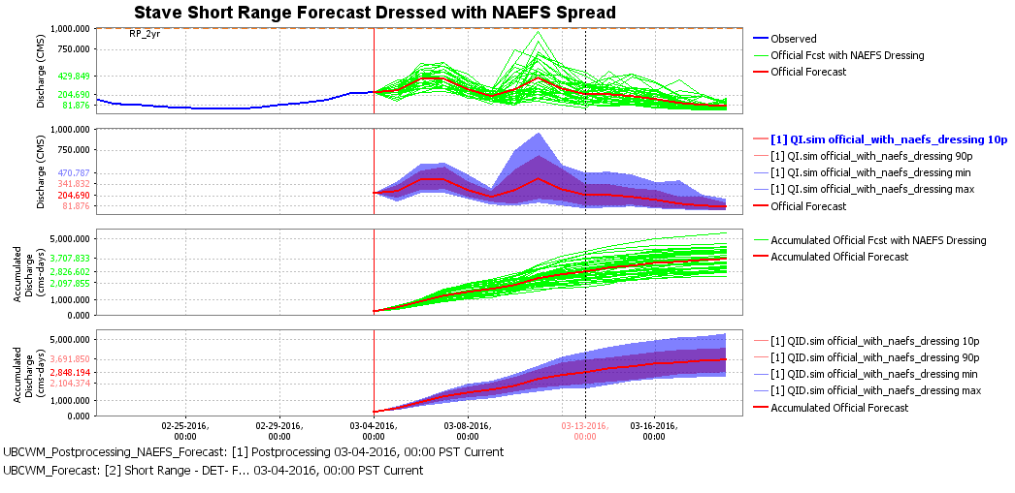
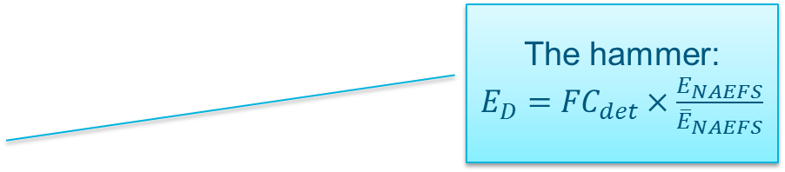
Raven ‘Dressed’ forecast
Sledge hammer: Center NAEFS spread around the official deterministic forecast
The hammer:
$E_{D}={FC}_{det}×\frac{E_{NAEFS}}{{\overline{E}}_{NAEFS}}$
NAEFS Uncertainty centered around deterministic forecast
Planners like the idea, performance not proven yet!

Slide 21
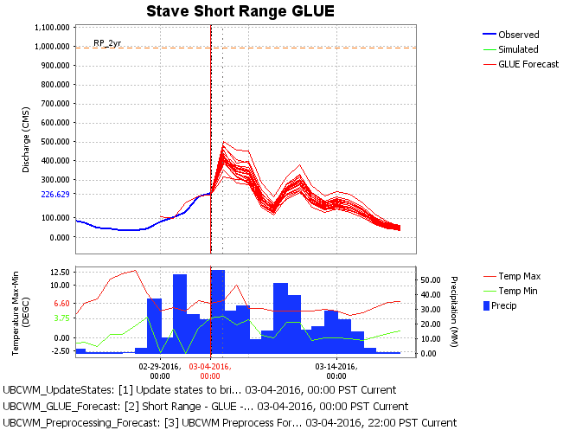
Uncertainty in hydrological model
Generalized Likelihood Uncertainty Estimation (GLUE) (Beven and Binley, 1992)
20 ‘behavioural’ parameter sets per basin
Identified thru GLUE-based calibration

Slide 22
Combining uncertain forecasts
How best to combine the uncertainty from the two sources?

Slide 23
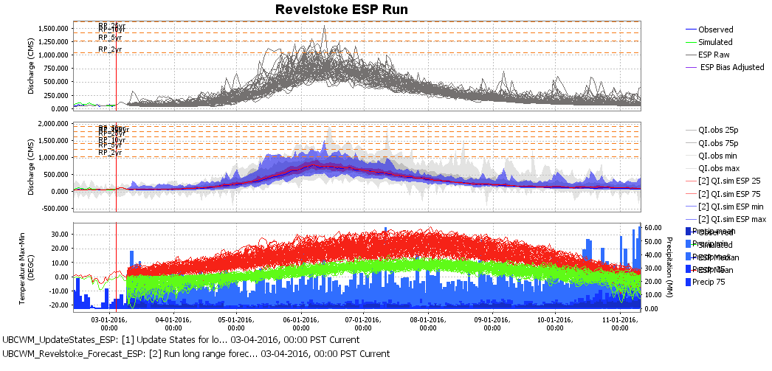
Long-range forecasting
Conventional ESP (with option to ingest short-range weather forecast)
Puts more emphasis on getting the volume rather than instantaneous flows
➔ We keep separate basin state conditions for short- and long-range forecasts

Slide 24
Merging forecasts with different time horizons
How can we merge short-range and long-range forecasts?

Slide 25
What’s next?
Hourly forecasting
Improve postprocessing
Multi model prediction
Improve model
Gridded forcing (forecast)
Explicit routing
Evaluation of short range ensembles

